Slide 1

Computational Gastronomy
Project: Cuisine prediction and cuisine similarity using yummly dataset and predicting wine quality using wine dataset.
Submitted by:
Abhishek Vyas (MT19086)
Era Sharma (MT19121)
Saumya Jain (MT19098)

Slide 2

Cuisine prediction using yummly dataset
Introduction
Problem Statement: Prediction of the cuisines based on the ingredients using the yummly dataset. In this dataset, there are 3 columns: ‘ID’, ‘Ingredients’ and ‘Cuisine’. There are 39774 different recipes, each recipe is associated with a cuisine. Each recipe is the set of its ingredients. There are 20 different cuisines in total. We need to predict the cuisine based on the ingredient set given from the data.

Slide 3
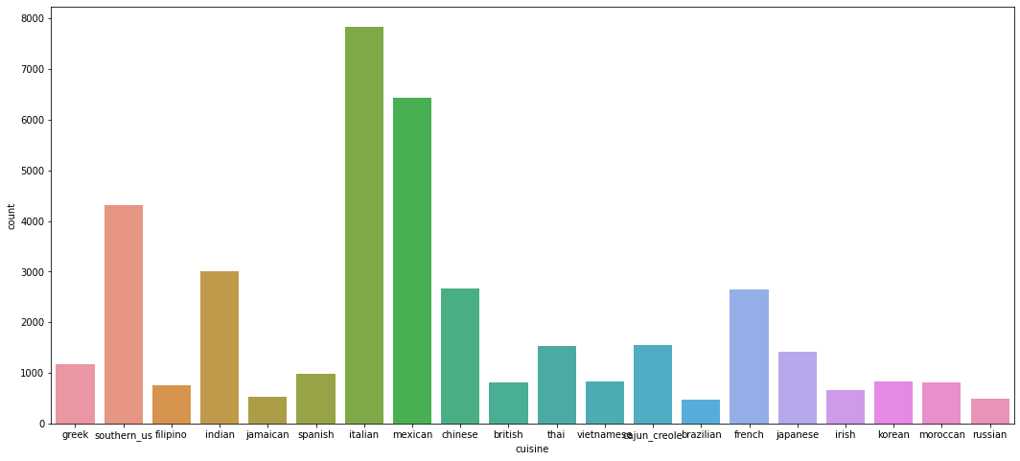
Analysis
Number of Recipes vs cuisine graph

Slide 4

Work Done
To predict the cuisines from the ingredient set we have used different preprocessing steps, Features are extracted and prediction is done using different machine learning models.
Preprocessing:
Duplicate recipes are checked: No duplicate recipe is present.
NaN values are checked: No nan values are there.
Data is tokenized and re is used.
Label Encoder is used.
Feature Extraction:
Technique 1
Tfidf based features are extracted using tfidfVectorizer.
Sparse Matrix is made
Technique 2
A dataframe of all 39974 rows and 6715 columns is created
0/1 is filled if that ingredient is present in that cuisine or not.

Slide 5

Work Done
Data is split into training and testing.
Different Machine Learning Models are applied:
Logistic Regression
K Nearest Neighbor
Cosine based Similarity
Decision Tree
Random Forest

Slide 6

Results:
The accuracy for 80:20 split for different models comes out to be:
Technique 1:
Technique 2:
Models | Accuracy
Logistic Regression | 0.7812
K Nearest Neighbor | 0.7355
Cosine based Similarity | 0.6926
Decision Tree | 0.6080
Random Forest | 0.7406
Models | Accuracy
Logistic Regression | 0.692
K Nearest Neighbor | 0.602
Decision Tree | 0.6921
Random Forest | 0.69
in first technique logistic regression performed better and in second logistic and decision tree performed but had less accuracy as compared to technique 1

Slide 7
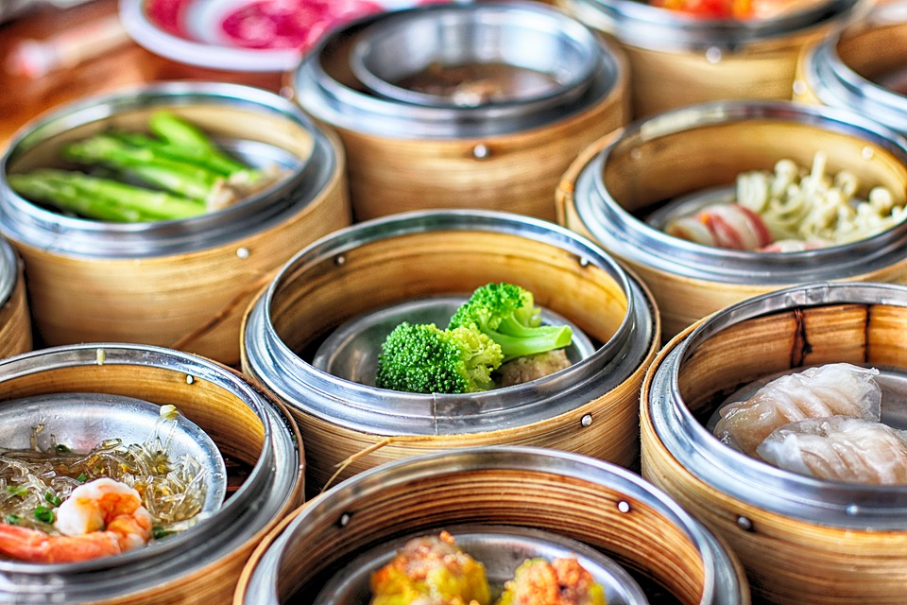
Cuisine similarity using yummly dataset
Introduction
Problem Statement: Predicting Cuisine similarity based on the ingredients using the yummly dataset. In this dataset, there are 3 columns: ‘ID’, ‘Ingredients’ and ‘Cuisine’. There are 39774 different recipes, each recipe is associated with a cuisine. Each recipe is the set of its ingredients. There are 20 different cuisines in total. We need to predict the most similar cuisine based on the ingredient set given from the data.

Slide 8
Work Done
We have applied below two techniques to perform cuisine similarity.
Preprocessing:
All pre processing is same as done in cuisine prediction.
Technique 1: Based on matching ingredients
We created list of unique ingredients in all 20 cuisines and matched the number of ingredients shared between every two cuisines ,the cuisine with maximum ingredients shared is considered as similar to that cuisine.
Technique 2:TF-IDF based cosine similarity
TF-IDF based cosine similarity is calculated using the recipes(set of ingredients).
Features are extracted and most similar cuisine out of all is calculated by majority voting of the cuisines, based on the training and testing data.

Slide 9
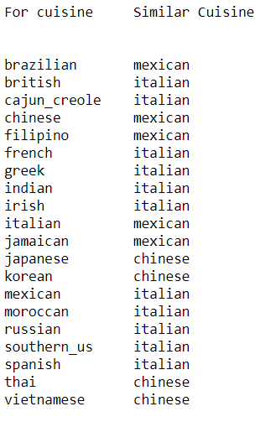
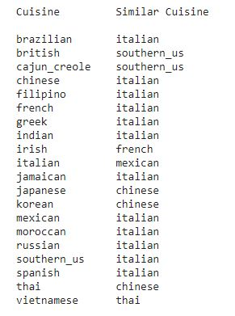

Results:
Technique 1 Technique 2
We found that 80% results matched in both the techniques and many cuisines are correctly predicted as validated from the internet.

Slide 10

Red wine Quality dataset analysis and quality prediction
Objectives:-
Analysis of Red wine quality dataset including outlier detection and removal.
Prediction of wine quality based on different features using regression model and show betterment of result after outlier removal.
Predicting whether a particular red wine “good quality” or not using various classification models.
The quality of is determined by 11 input attributes
which are as:-
Fixed acidity, Volatile acidity, Citric acid,
Residual sugar, Chlorides,
Free sulfur dioxide, Total sulfur dioxide,
Density, pH, Sulfates, Alcohol

Slide 11
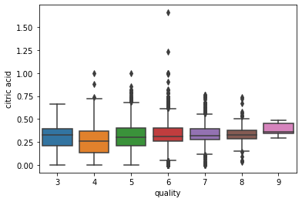
Preprocessing, Analysis and Outlier Detection
Remove duplicate rows : (before:6497 , after: 5329 )
Check if any row have all Nan : no such row found.
Check % of NULL values in each column : we remove all such row in which any column have NULL values ( 0.53 % of data is deleted )
Make heatmap and remove column ID as have all unique values.
Scale the data in range of 0 to 1 using MinMaxScaler
We use various plots for our analysis and outlier detections as Box plot, Scatter Plot, Histogram plot. For “Citric acid” plots are as:-

Slide 12
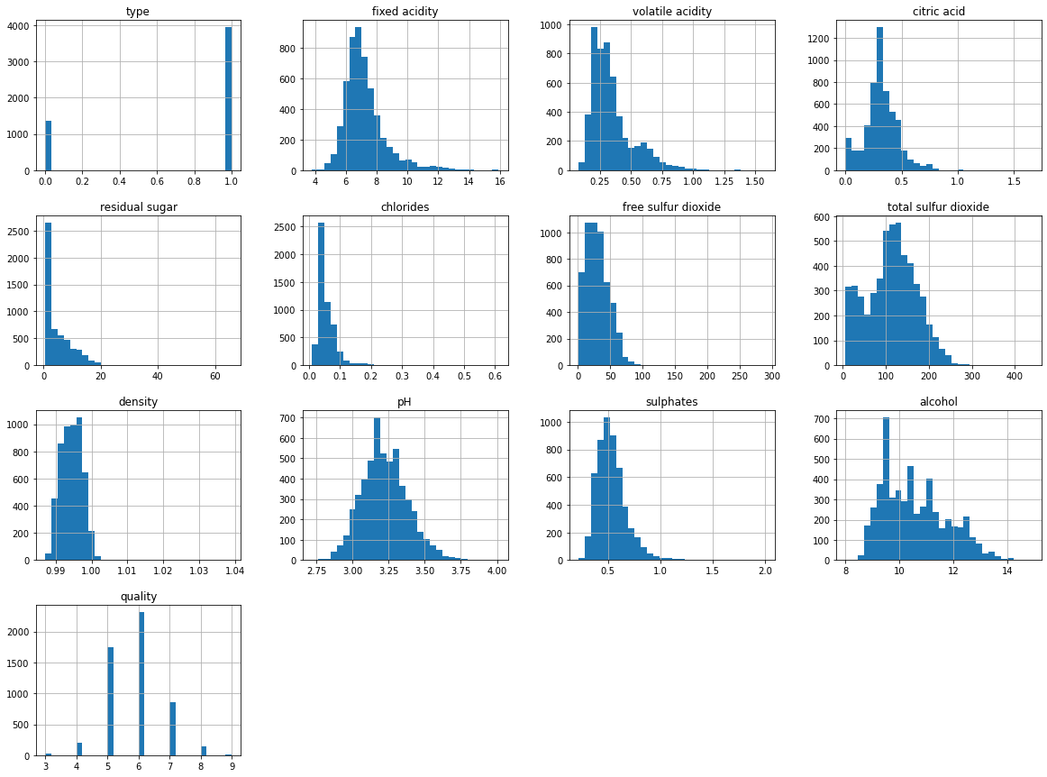
Histogram plots for each attribute (bins=30)

Slide 13
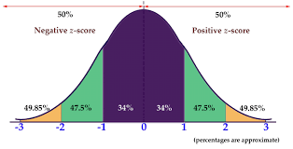
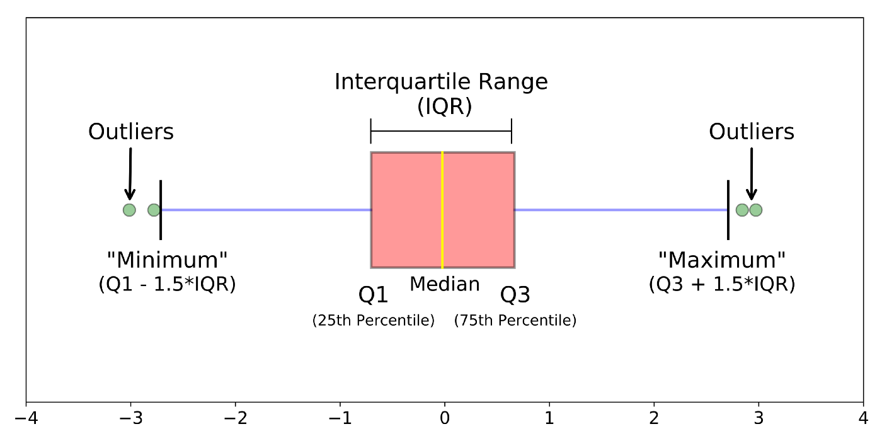
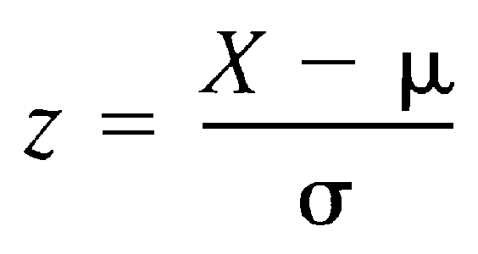
Removing outliers (Z-Score and IQR method)
Z-score => We can find out numbers of standard deviation values away from mean. Here in our case we take data which is in range between -3sd to +3sd.
IQR( Inter Quartile Range ) => In this method we detect outliers using IQR which tell us the variation in the dataset. Here any value which is beyond the range for Q1-1.5 * IQR to Q3+1.5 * IQR is treated as outlier, where IQR= Q3 - Q1.

Slide 14
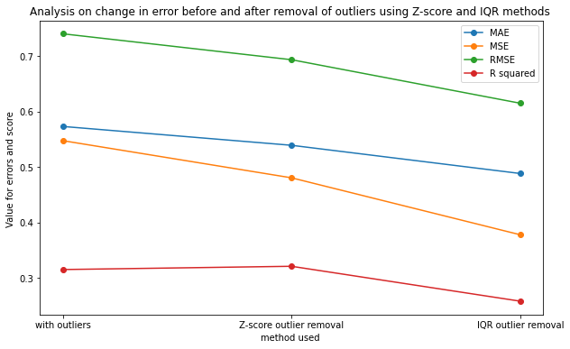
Prediction Using Linear Regression and Betterment of result
We implement Linear Regression using sklearn on dataset before removing the outliers and after removing the outliers and compare various evaluation matrics results in different cases which are as:-
 | With Outliers | After Z-score | After IQR
MAE | 0.5731 | 0.5392 | 0.4884
MSE | 0.5476 | 0.4806 | 0.3781
RMSE | 0.7399 | 0.6932 | 0.6149
R squared | 0.3154 | 0.3213 | 0.2821

Slide 15
Wine Quality prediction using Classification
We predict whether a particular red wine “good quality” (quality >= 6) or not (score <=5). using various classification models.
Result are as follows :-
 | Accuracy | Precision | Recall | F1_score
Decision Tree | 0.6858 | 0.7609 | 0.7484 | 0.7546
GaussianNB | 0.7292 | 0.7994 | 0.7750 | 0.7870
SVM | 0.7858 | 0.7988 | 0.8932 | 0.8434
Random Forest | 0.7785 | 0.8051 | 0.8665 | 0.8347

Slide 16

Thank You
Any Questions??

